Slide 1
Coptic Lesson 19 Past Continuous Tense

Slide 2
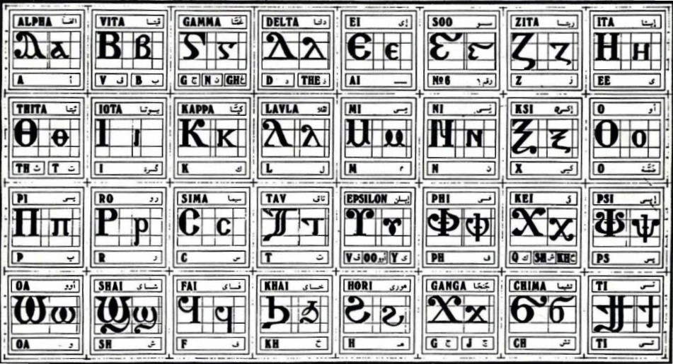
Coptic Alphabets

Slide 3
Review Questions
Coptic
Name
English
b
Veeta
b, v
[
Cheema
ch
¢
marteroc
Martyr
=p=y
qamne-`smyn
88
=f^
pictau-coou
96
} ]
Tee
ti
=t=i=y
Somt-se-myt-`smyn
318

Slide 4
Rule for the Kei <:
k
(in a Coptic Word)
< , =
sh
(Gk, before the e-family)
e-family:
e> y> i> u
kh
(Gk, otherwise)
Examples:
,ymi
,aric
,ere
`,rwm
Ar,y
Mona,oc
,w
Lu,nia
Pi,iwn
,wra
Ic,uroc

Slide 5
Vocabulary List
nau
to look
ouwn
to open
ouws
to want
ouwnh
to appear
ouwrp
to send
ouwst
to worship

Slide 6
Coptic Bible Verses – Part 3
Rasi qen `P[oic `ncyou niben Rejoice in the Lord always. (Phil 4:4)
Twbh `ejen neten`eryou Pray for one another. (Jm 5:16)
Vnou] ouagapy pe God is love. (I Jn 4:16)
Jemnom] anok ai[ro `epikocmoc Be of good cheer, I have overcome the world. (Jn 16:33)
}ar,y `n]covia ]ho] `nte `P[oic te The fear of the Lord is the beginning of wisdom. (Ps 110:10)

Slide 7
Beginner Vocabulary Review
romi kahi `Vnou] `alou ioh
ry con syri iwt bal
yi ran ro ouro nyb
`chimi vorsi seri ourw ri
cwni ajp ve sau soury
mau ]`alou jij `;nyb hiomi
nicwni nirwmi niran nimau ni`alou
jom niourw nibal nisau ninyb
niseri totc io] ourwou vyou`i

Slide 8
Past Continuous Tense
nainau
naknau
narenau
nafnau
nacnau
nannau
naretennau
naunau
I was looking
you were looking (masculine)
you were looking (feminine)
he was looking
she was looking
we were looking
you were looking (plural)
they were looking

Slide 9
Exercise (Part 1)
Use the following verbs to form a past continuous tense:
ouwn
to open
ouwnh
to appear
caji
to speak
jerjer
to play
ouwrp
to send
cw
to drink
ouws `e
to want to
ouwst
to worship

Slide 10
Exercise (Part 2)
Translate the following into English:
Nakmosi qen pi[wm
You were walking in the garden.
Nai`cqai `mpaws
I was writing my lesson.
Nac`areh `nje tacwni
My sister was studying.
Nan`slyl nem nen`cnyou
We were praying with our brothers.
Naretenhemci `mmau
You were sitting there.
Naunau `eniaggeloc
They were looking at the angels.
Naretenouwst `mV]
You were worshipping God.
Naf,w `ntefjij hijen tef`ave
He was putting his hand on his head.

Slide 11
Announcement
All slides are available at http://www.ekladious.com/coptic.html

Slide 12

Oujai qen `P[oic

